Slide 1
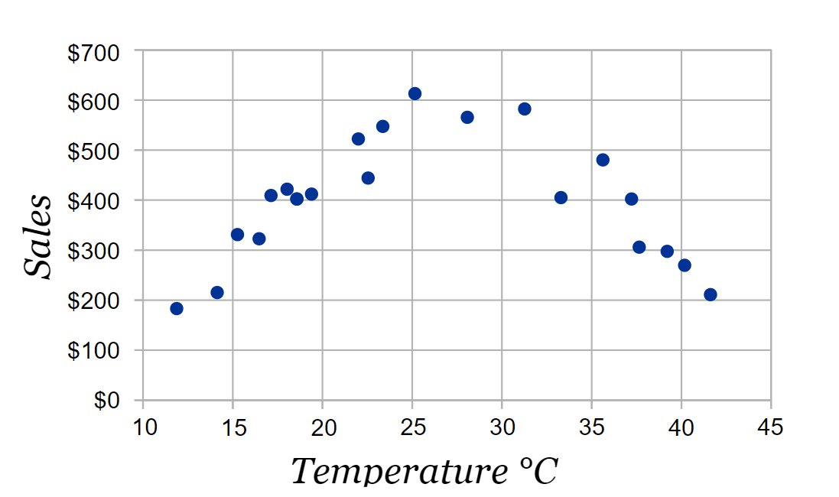
Unit 3 Chapter 1C
Bivariate data is data for two variables (usually two types of related data).
A scatter plot can be used to display bivariate data and show any connections that might exist between the variables.
A scatter plot uses the data to create a series of points drawn on a pair of axes, with each axis representing the values of one of the two variables.
The explanatory variable is plotted on the x axis and the response variable is plotted on the y axis.
This is a scatter plot showing data for temperature (°C) and ice cream sales.
Temperature is the explanatory variable.
Ice cream sales is the response variable.

Slide 2
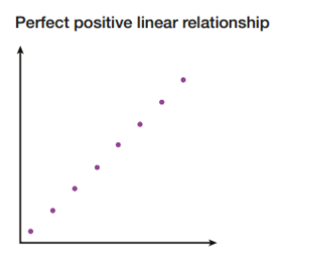
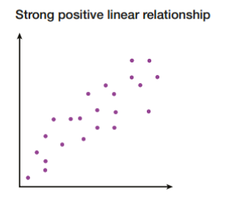
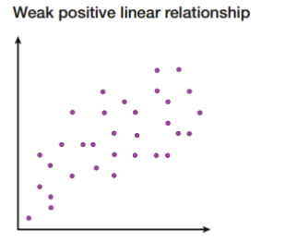
Unit 3 Chapter 1C
A scatter plot makes it easier to see any relationships that might exist between the variables you are looking at.
Sometimes, the points on the scatter plot will look as though they are almost forming a straight line.
If one variable increases as the other increases, the relationship is positive (we call this positive correlation).
If one variable increases as the other decreases, the relationship is negative (negative correlation).

Slide 3
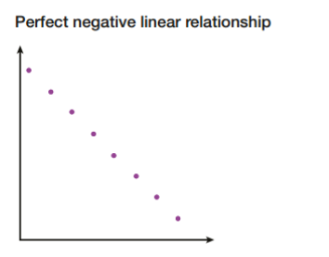
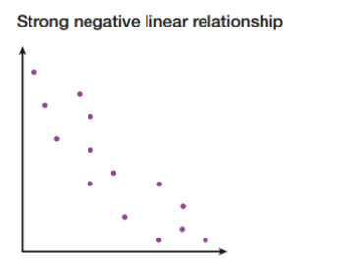
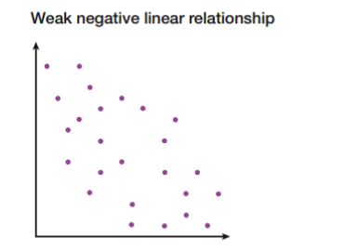
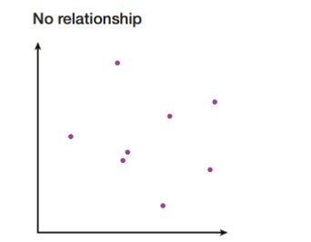
Unit 3 Chapter 1C
A scatter plot makes it easier to see any relationships that might exist between the variables you are looking at.
Sometimes, the points on the scatter plot will look as though they are almost forming a straight line.
If one variable increases as the other increases, the relationship is positive (we call this positive correlation).
If one variable increases as the other decreases, the relationship is negative (negative correlation).

Slide 4
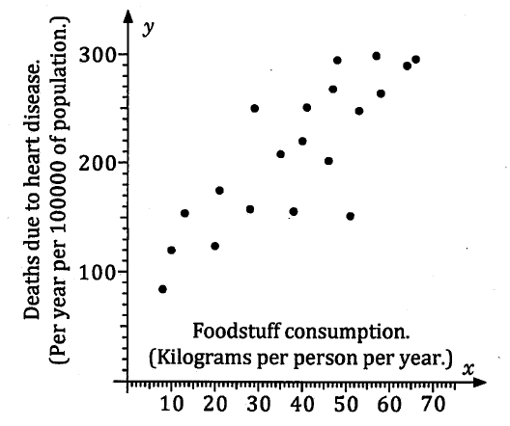
Unit 3 Chapter 1C
If we think again about the study done on countries consumption of a particular food and their rate of death due to heart disease, we can represent this data by using a scatter plot. As the food consumption is the explanatory variable, we plot it on the x axis and the number of deaths due to heart disease on the y axis (as it is the response variable).
We can say that in general, countries with lower consumption have lower heart disease deaths and countries with higher consumption have higher heart disease deaths. There seems to be an association, or correlation, between the food consumption and the death rate due to heart disease.
This attempts to summarise an underlying trend suggested by the scatter plot. Not every individual will necessarily fit the trend, but we can comment on the general trend.

Slide 5
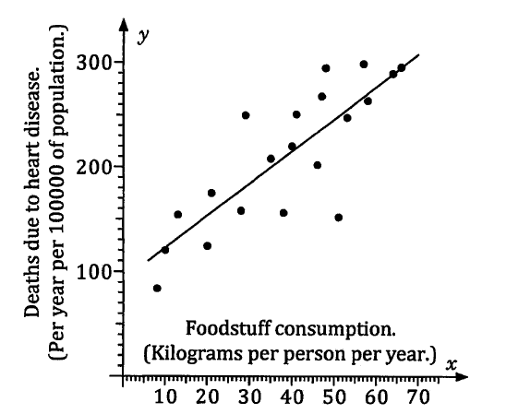
Unit 3 Chapter 1C
We could attempt to draw a straight line that seems to ‘best fit’ this data. In this way, we are fitting a linear model to the situation which we could then use to make predictions.
Using our line of best fit, we could suggest that a country with an intake of 45 kg of person per year of the food might have a heart disease death rate of approximately 230 persons per year per 100 000 population.

Slide 6
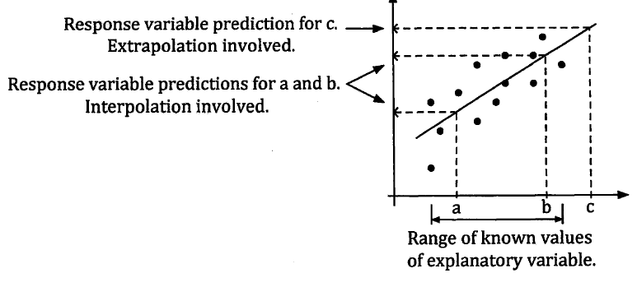
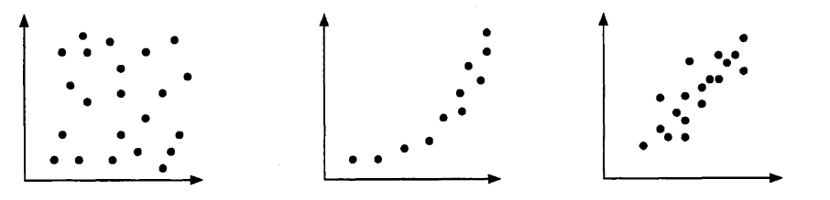
Unit 3 Chapter 1C
When considering how reliable our predictions are:
Do the points on the scatter plot suggest a linear model, or perhaps a curve or no relationship?
How many points does our scatter plot have? The more we have, the more confident we can be in any suggested model.
How closely do the points fit the model? The closer the points lie to a straight line, the better the model is.
Are we predicting a value within the spread of our data or is it for a value beyond this? If the value we are predicting lies within the spread, this is interpolation whereas if the predicted value lies outside it, this is extrapolation and is likely to be less reliable (and even less reliable the further outside of known values we go).

Slide 7
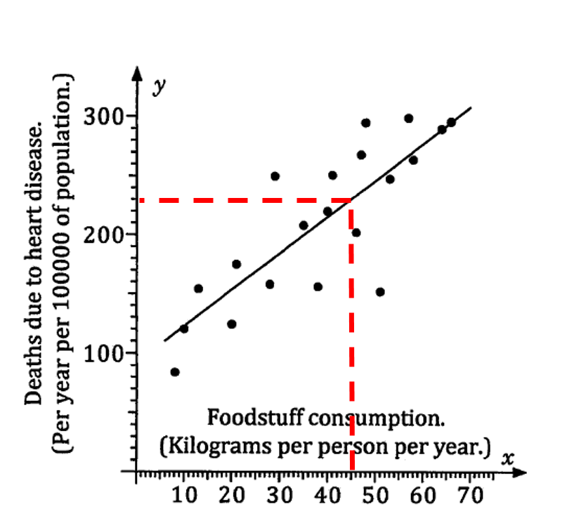
Unit 3 Chapter 1C
Now try Exercise 1C
Going back to our original investigation, we predicted that a country with consumption of 45 kg per person per year would have 230 heart disease related deaths per year per 100 000 population.
We can be reasonably confident of this prediction as:
The graph suggests a linear model is appropriate.
The graph involves a reasonable amount of points.
The figure of 45 kg per person per year is within the values covered by the data so it is interpolation.
However, we would not be so confident if we continued our line of best fit to predict what would happen with 90kg of consumption per person per year as this would be extrapolation.

